Slide 1


My work
for BRANE
Private LLM Chat Bot
Back to Primary Portfolio

Slide 2
Stringer Overview
Stringer is a private LLM chatbot equipped with advanced features including LLM bot functionality, individual and group chat, voice and video calls, broadcast messaging, alerts, and notifications. It is driven by IRDR, seamlessly integrating AI to enhance interactive communication and transaction processes.

Slide 3
Objectives
- Communication for all stakeholders of the company.
- Knowledge sharing space for all stakeholders.
- Tracking space for Project managers.
- Sprint planning for developers

Slide 4
Target Audience
- Software Developers
- Content writers
- Product Managers
- Project Managers

Slide 5
Following are the screenshots of executed output.

Slide 6
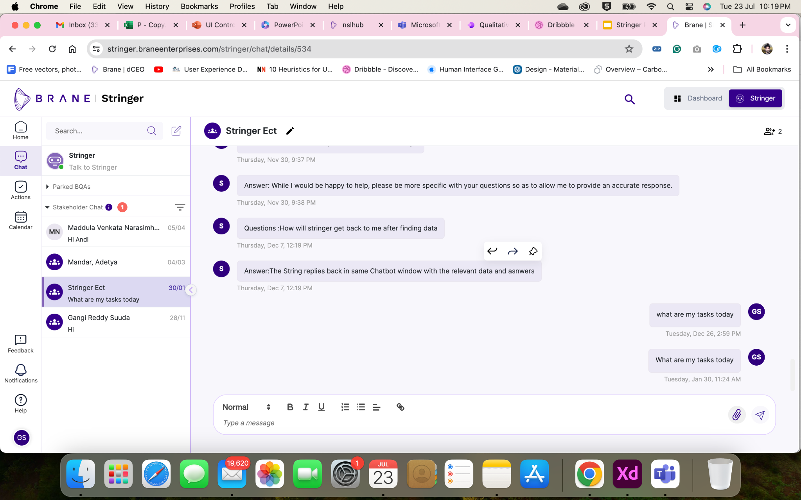
Individual/Group Chat

Slide 7
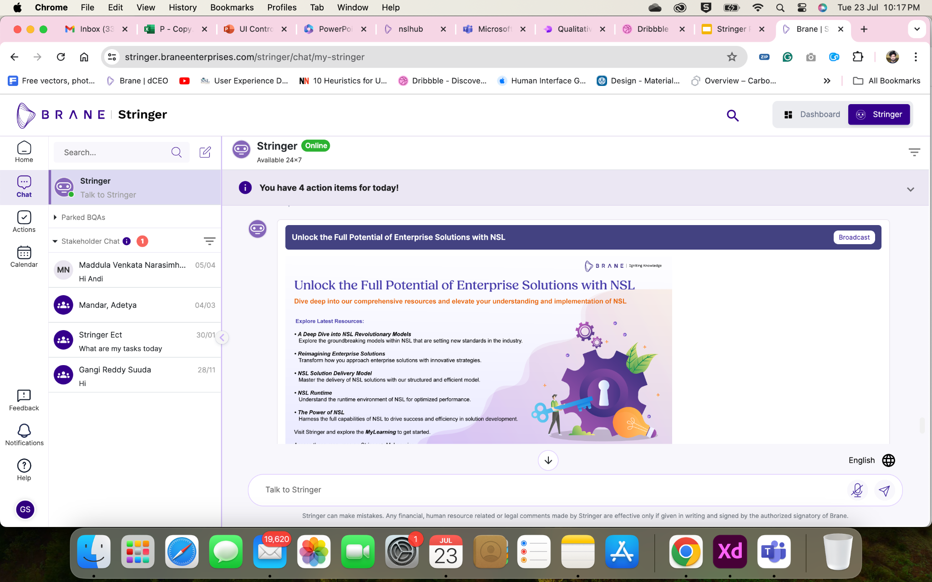
Private LLM Chat

Slide 8
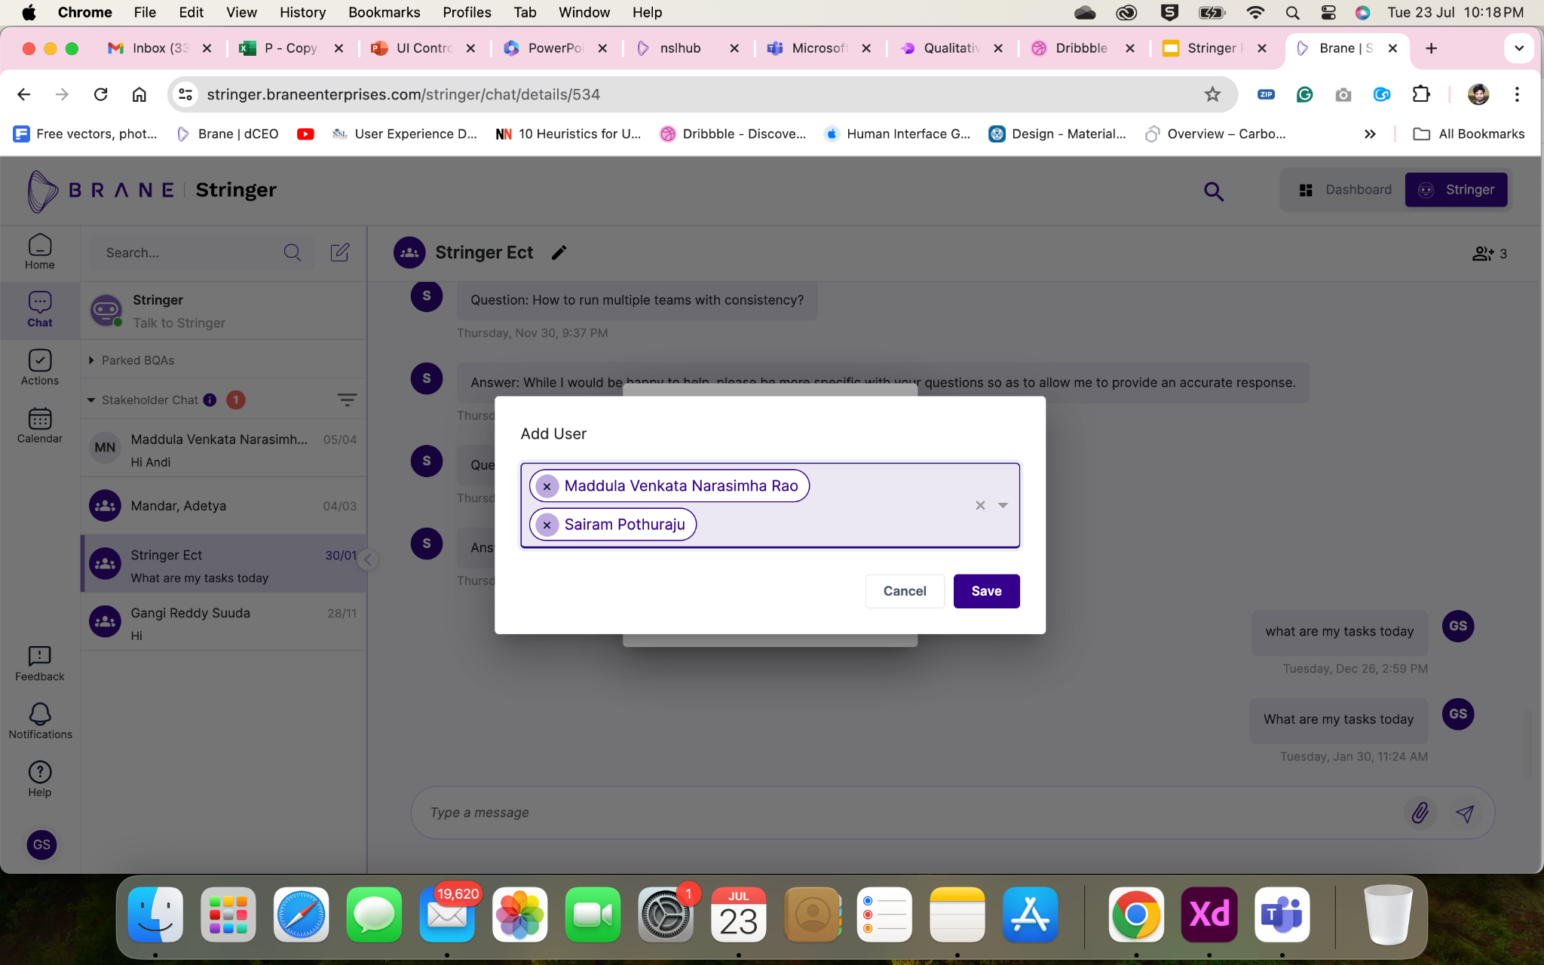
Creating Group

Slide 9
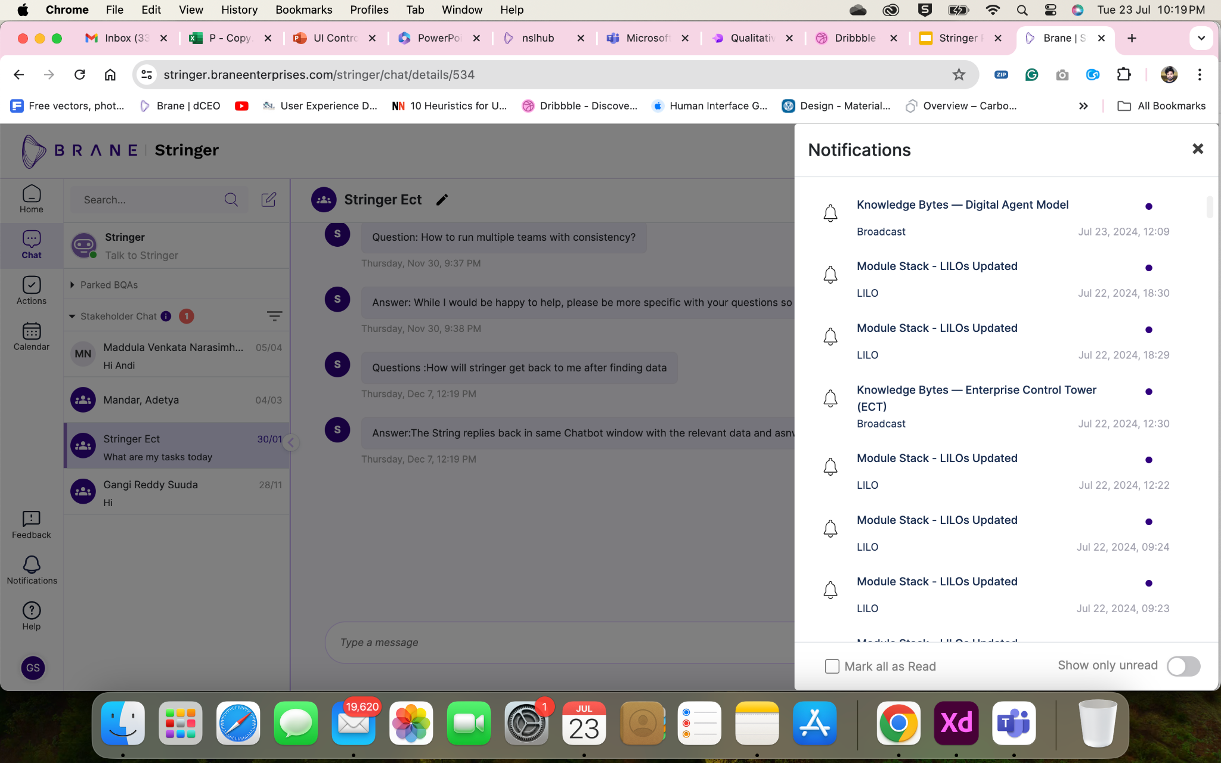
Notifications

Slide 10
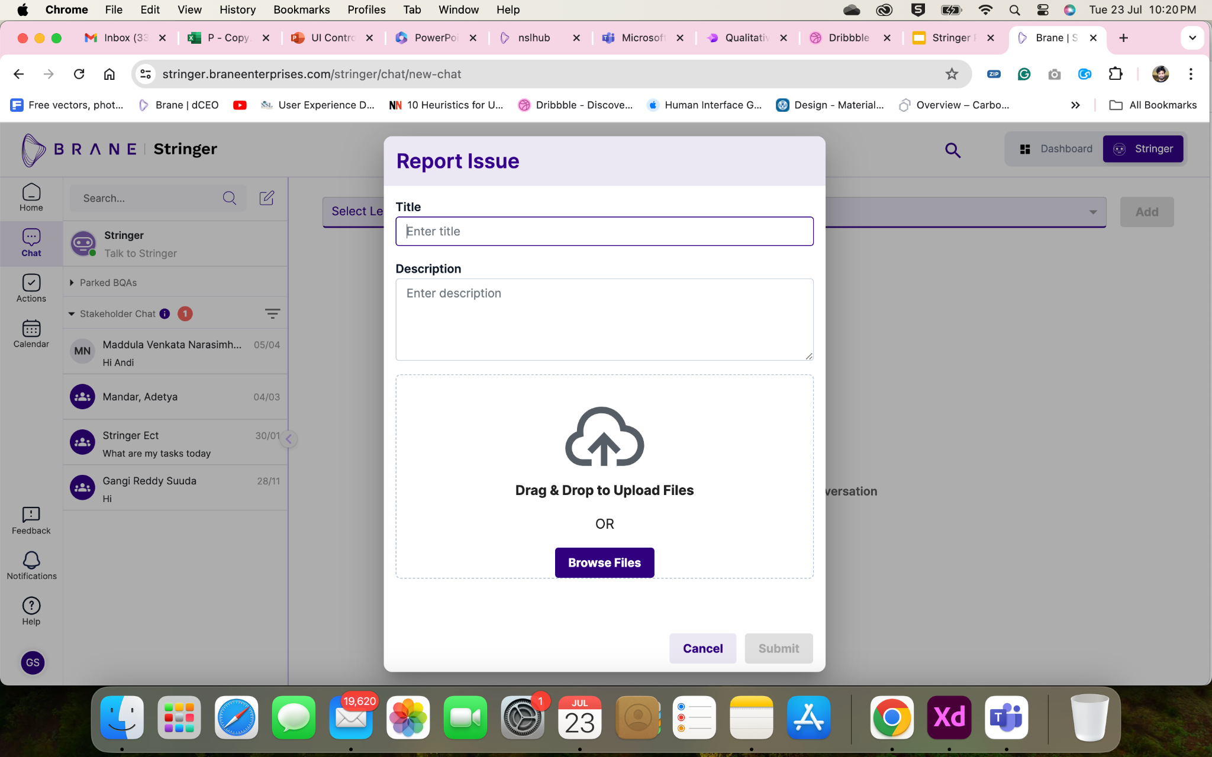
Feedback System

Slide 11
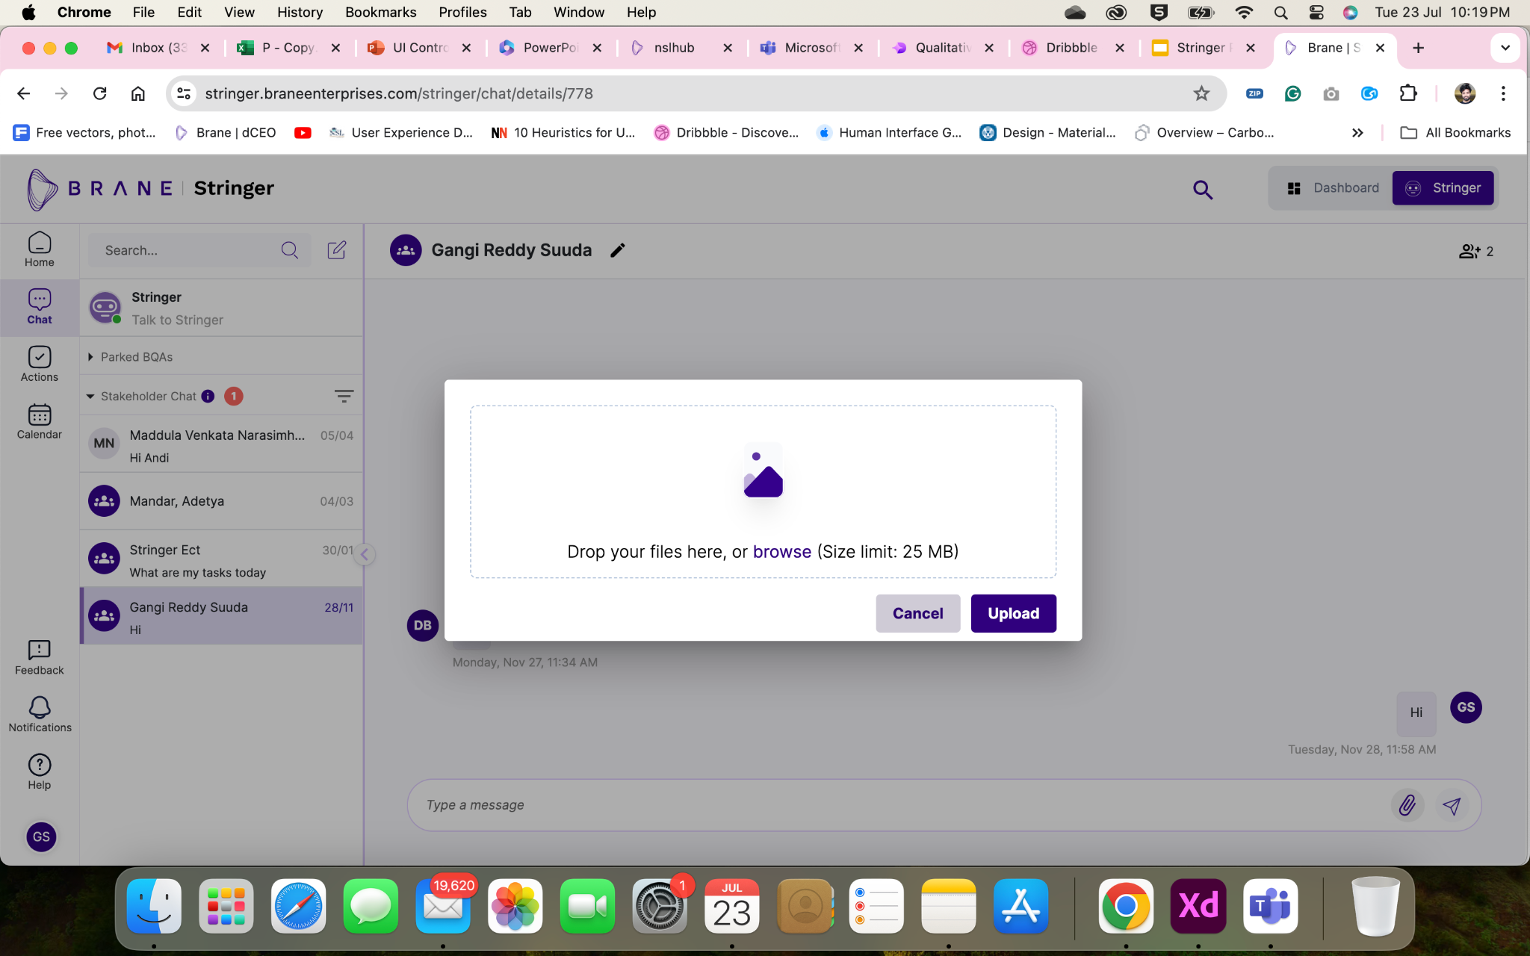
File Sharing

Slide 12
Thank You

